Slide 1


ETHICS AND COPYRIGHT
Artificial intelligence
Keely O’Dowd, Lander & Rogers
Scott Traeger, Lander & Rogers
Laurence White, Svenson Barristers
Susan Gatford, Svenson Barristers
July 2024

Slide 2
Artificial intelligence and legal ethics
Laurence F. White
Barrister
25 July 2024
CPD presented to Lander and Rogers
Laurence.White@vicbar.com.au
© 2022 Laurence White

Slide 3
Outline
Introduction to advanced AI tools
Possible use cases for advanced AI tools in legal practice
What’s under the hood?
  Technologies
  Terms and conditions / privacy policies
Challenges
  Accuracy, completeness, bias
Most relevant ethical rules
Guidance from Courts and professional associations
Tentative conclusions
Case study outline

Slide 4

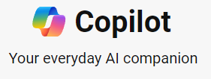








Introduction to advanced AI tools
General purpose
Specialist legal

Slide 5
Possible legal use cases for advanced AI tools
Research
  Legal research
  Summarise cases / generate headnotes
  Suggest lines of inquiry
General
  Summarise client conferences (eg Teams auto transcript/summary)
  Automate client onboarding / client questionnaires
  Summarise matter files / chat with matter
Discovery/forensic
  Summarise/analyse evidence
  Timeline generation
  Identify contradictions / gaps in evidence
  Automate LPP / relevance review
  Network analysis

Slide 6
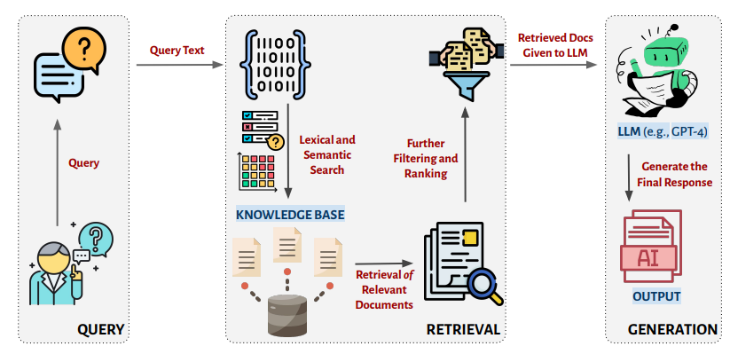
What’s under the hood? – RAG example
Schematic diagram of a retrieval-augmented generation (RAG) system. Given a user query (left), the typical process consists of two steps: (1) retrieval (middle), where the query is embedded with natural language processing and a retrieval system takes embeddings and retrieves the relevant documents (e.g., Supreme Court cases); and (2) generation (right), where the retrieved texts are fed to the language model to generate the response to the user query. Any of the subsidiary steps may introduce error and hallucinations into the generated response. (Icons are credited to FlatIcon.)

Slide 7
Challenges with large language models (LLMs)
Accuracy
Bias
Intellectual property
Privacy and data security
De-skilling / motivation?

Slide 8
Accuracy
Magesh et al., “Hallucination-Free? Assessing the Reliability of Leading AI Legal Research Tools”, forthcoming

Slide 9
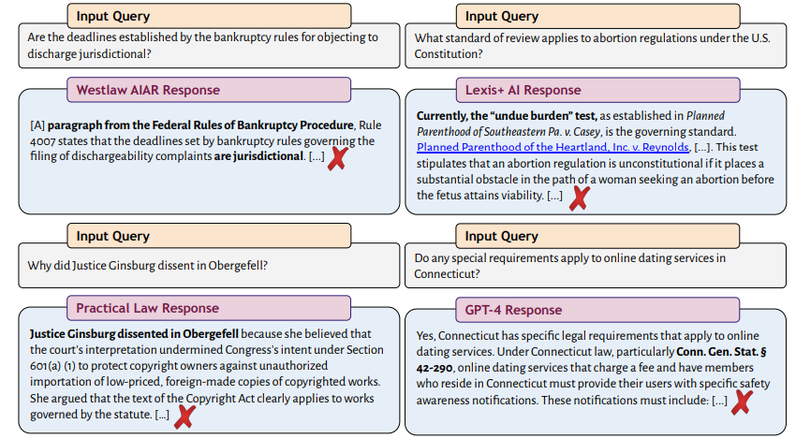
The system makes up a statement in the Federal Rules of Bankruptcy Procedure that does not exist.
Casey and its undue burden standard were overruled by the Supreme Court in Dobbs v. Jackson Women’s Health Organization, 597 U.S. 215 (2022); the correct answer is rational basis review.
The system fails to correct the user’s mistaken premise—in reality, Justice Ginsburg joined the Court’s landmark decision legalizing same-sex marriage—and instead provides additional false information about the case.
Example of a hallucinated response from GPT-4, which generates a statutory provision that does not exist.
Magesh et al., “Hallucination-Free? Assessing the Reliability of Leading AI Legal Research Tools”, forthcoming

Slide 10
Legal Profession Uniform Law Australian Solicitors' Conduct Rules 2015
Rule 4: Competence, integrity and honesty - lawyers are responsible for advice accuracy
Rule 9: Confidentiality - inputting client info into public AI may breach confidentiality
  Enterprise Ts & Cs may promise privacy – but see next slide
  Private instance of LLM may overcome confidentiality concerns
Rule 17: Independence - lawyers must exercise independent judgment, not just defer to AI
Rule 19: Duty to the court - lawyers must ensure AI-produced material is valid and not misleading
Rule 37: Supervision - those supervising junior lawyers must critically evaluate AI outputs

Slide 11
Terms and conditions / privacy policies
Terms and Conditions and Privacy Policies are often hard to find or consist of many documents (e.g. Microsoft Copilot / O 365 )
Consumer Ts & Cs differ from “Plus” paid Ts & Cs which may also differ from Enterprise Ts & Cs, which may be bespoke
T & Cs also change frequently and without notice
  How often are you willing to do due diligence?
  Do you have a robust process to document / archive Ts & Cs?
Generally, consumer and some “Plus” paid Ts & Cs do not promise that user input will not be used to train the LLM
  Danger of information leakage to model owner
  Danger of information leakage to other users
  Do you understand what could happen with your/your client’s data?
  Could your client give informed consent?
Mid-tier plans often have patchy privacy/confidentiality – e.g. Open AI Plus – private setting is device-level not account-level
Enterprise Ts & Cs differ but often contain a promise of sorts not to use prompts or outputs to train the model
APIs – Ts & Cs will differ again and will be relevant where a public LLM is integrated into another product (such as Smokeball)
Privacy policies will cover personal identifying information (PII) but may not cover business confidential information at all. Jurisdictional questions may be quite thorny (eg does Australia’s Privacy Act apply?).

Slide 12
Victorian Supreme Court guidelines on the responsible use of AI in litigation (May 2024)
Parties and practitioners using AI tools in litigation should understand how they work and their limitations.
Information provided to external AI programs may not be private, confidential or secure.
Use of AI must not mislead others in the litigation process. Where appropriate, AI assistance should be disclosed to other parties and the court. Self-represented litigants are encouraged to identify when they have used generative AI to prepare documents.
Practitioners must still meet their obligations of candour to the court when using AI. Technology Assisted Review using machine learning for document review is encouraged when appropriate. Specialised legal AI tools are likely more useful and reliable than general-purpose tools.
Parties and practitioners remain responsible for the accuracy of documents filed with the court, even if AI assisted in preparing them. Documents and submissions made using AI must still have a proper basis. Generative AI output should be carefully checked by practitioners for issues like being out-of-date, incomplete, inaccurate, inapplicable to the jurisdiction, or biased.
Particular caution is needed if using generative AI to assist with affidavits, witness statements or expert reports, to ensure they reflect the knowledge and words of the relevant person.
AI and reasoning?
  "Generative AI and Large Language Models create output that is not the product of reasoning. Nor are they a legal research tool. They use probability to predict a given sequence of words."
  "AI is not presently used for decision making nor used to develop or prepare reasons for decision because it does not engage in a reasoning process nor a process specific to the circumstance before the court."

Slide 13
Law Society of NSW - Practice management tips:
Exercise same [or more!] care with AI as with human legal assistants
AI should supplement, not substitute, legal services
Educate employees on AI risks and benefits
Use precise prompts to improve AI output specificity and quality
Source: Law Society Journal, “A solicitor’s guide to responsible AI use”.

Slide 14
Tentative conclusions
Balance to be struck between extreme conservatism and extreme freedom
Provide your employees with corporate AI tools – lest they use personal AI tools to help them in their work
Guard against dangers of over-reliance on AI and de-skilling – 2nd pair of (human?) eyes
The “arms race” among providers will continue
AI will continue to become “vanilla” and be embedded in most legal information products
Basic legal research/writing and basic document summarization tasks may become commoditized – many will seek to focus on oral communication and face to face or other skills that will be less exposed

Slide 15
Case studies (with Keely O’Dowd)

Slide 16
Case study 1
Scenario
You are a senior lawyer at a firm which embraces legal technology and providing efficient and innovative solutions for clients.
It is 4:30 pm on a Friday and a client operating in the online retail space is eagerly awaiting some consumer law advice, before it goes live with a new sales promotion on the weekend.
Using ChatGPT you have generated a draft advice memo. The draft advice addresses all the points you would have considered, and it aligns with a precedent advice prepared by a colleague who regularly practices in consumer law.
Aside for some non-substantive amendments to specifically address the client’s factual matrix and some reformatting, you send the advice out by 5:00 pm (this will be a big win for the client and the firm)!
What are some relevant considerations that come to mind from this scenario?
Notes:
Speaking notes:
ChatGPT it is a trained large language model, it is not a specialised legal tool. To ensure the advice is informed by legal resources, tools such as Lexis + AI, Thomson Reuters CoCounsel, Westlaw AI&R and Practical Law AI are better options.
AI tools are prone to hallucinate and are great at using language to come across as being fully informed (eg no disclaimers or caveats).
With some AI tools (particularly some general/non-legal tools) there is a lack of visibility with respect to the underlying legal resources considered (if any).
Even specialist legal AI tools operate from limited data, ie their data bases may not address recent consumer law updates or nuanced principles.
Thus, lawyers must not have a false sense of security regarding the accuracy of the output of AI tools.
With ASCR 4 in mind, ie the need to provide competent legal advice, the lawyer in this scenario should have:
verified the output, with independent research or even conferring with their colleague, to ensure no points (especially updates in law) were missed.
Practical advice: treat AI (even legal AI) as an enthusiastic, capable but overly confident and inexperienced intern. Clear instructions and thorough independent verification is required.

Slide 17
Case study 2
Scenario
You (being a senior lawyer) are working on a litigious matter, for which a junior lawyer, Josephine, is assisting you.
Josephine is proactive and tech savvy. You have given her the responsibility of interviewing the client and preparing an affidavit. You are confident that Josephine will do a good job as she has done this task before (and after all you trained her).
Josephine has sent across the affidavit for your approval and notes that she used MS CoPilot to transcribe the recorded client meeting (which was held via MS Teams) and then instructed CoPilot to use the transcription to prepare an affidavit. She has confirmed that she has already proof read the affidavit.
You are impressed with Josephine’s resourcefulness, the efficiency will be welcomed by the client!
What are some relevant considerations that come to mind from this scenario?
Notes:
Speaking notes:
Starting point did Josephine get the client’s consent for: the recording and the use upload of their personal information to CoPilot?
CoPilot, like many other AI tools, retains inputted data.
ASCR 8 regarding the need to follow client instructions and ASCR 9 – regarding confidentiality, are things to consider from a professional obligations perspective. Additionally, client should have provided fully informed consent.
AI tools are prone to ‘hallucinate’, the Victorian Supreme Court’s guidance with respect to the use of AI in litigation notes the risk that affidavits prepared by AI may not accurately reflect the client’s knowledge, thoughts and words.
ASCR 4 regarding the need to provide competent legal services is important to keep in mind.
AI can be influenced by various data which may be biased/discriminatory in nature.
A thorough review of the of the affidavit is required to ensure that no misrepresentations (however slight) have been made.
ASCR 37 regarding the need to supervise junior lawyers is important to consider as you should verify not only the output but also the method which has been applied to create the output.

Slide 18
Laurence F. White
Barrister
Owen Dixon Chambers West
Phone: +61 3 9225 6038
Clerk: Svenson Barristers | +61 3 9225 7333
Laurence.White@vicbar.com.au
www.vicbar.com.au/profile/8372
Liability limited by a scheme approved under professional standards legislation.
This presentation does not constitute legal advice.
No representation is made as to the accuracy of material cited or reproduced.

Slide 19

Copyright and Artificial Intelligence Systems
SUSAN GATFORD
COMMERCIAL BARRISTER
NATIONALLY ACCREDITED MEDIATOR
TRADE MARK ATTORNEY

Slide 20
Copyright basics
Copyright Act 1968 (Cth)
no registration system
section 32 - copyright exists in works - a literary work, dramatic work, musical work or an artistic work
there is also a separate copyright in sound recordings, cinematograph films, television broadcasts and sound broadcasts

Slide 21
Types of works
A literary work, includes
(a) a table, or compilation, expressed in words, figures or symbols, and
(b) a computer program or compilation of computer programs
An artistic work means
(a) a painting, sculpture, drawing, engraving or photograph, whether the work is of artistic quality or not;
(b) a building or a model of a building, whether the building or model is of artistic quality or not; or
(c) a work of artistic craftsmanship whether or not mentioned in paragraph (a) or (b)

Slide 22

Multiple copyrights
A physical item (which includes a computer file) can contain several different and separate copyrights
A playlist of 10 song tracks will have 10 sound recordings, 10 musical works, and 10 sets of song lyrics, each of which will be protected by its own copyright, i.e. 31 individual copyrights, as the playlist itself will have its own copyright as a compilation

Slide 23
Copyright ownership
Section 35 – generally, the author or authors are the owners of the copyright
Section 35(6) – generally, employers own copyright in works created by their employees

Slide 24
Identify your works and authors
Copyright does not protect ideas, information, styles or techniques
Copyright does not protect names, titles or slogans
It ONLY protects rights in works or other subject matter
The originality threshold is low
Telstra Corporation Limited v Phone Directories Co Pty Ltd [2010] FCA 44 (Gordon J) at [344] approved in Chou v Metstech Pty Limited [2023] FCAFC 205 at [34]-[36]

Slide 25
Copyright owner’s rights – s31
Copyright, in relation to a work, is the exclusive right in the case of a literary, dramatic or musical work :
to reproduce the work in a material form;
to publish the work;
to perform the work in public;
to communicate the work to the public;
to make an adaptation of the work;
to do the above in relation to an adaptation of a work
(and for artistic works to do the acts in bold)

Slide 26
Infringement - s36
exercising, without the licence of the copyright owner, any of the exclusive rights of the copyright owner – reproducing, publishing, communicating a work to the public, making an adaptation of a work or performing a work in public
OR authorizing the doing of any of the above
AND you don’t need to reproduce the whole of a work to infringe copyright – you only need to reproduce/communicate a (qualitatively) substantial part of the work

Slide 27
Authorisation – section 36(1A)
(a) the extent (if any) of the person’s power to prevent the doing of the act concerned
(b) the nature of any relationship existing between the person and the person who did the act concerned
(c) whether the person took any reasonable steps to prevent or avoid the doing of the act, including whether the person complied with any relevant industry codes of practice

Slide 28
Duration of copyright
s33 – for works, life of the author plus 70 years
for works of joint authorship the copyright expires 70 years after the last joint author dies
another reason to know who all the authors are

Slide 29

AI systems
AI systems have been trained using data in the form of copyright works and other copyright subject matter from a wide range of sources
AND largely without regard to the copyright status of the training materials

Slide 30
USA litigation examples
Getty Images v Stability AI - 12 million Getty Images photographs are alleged to have been infringed, along with their captions and metadata
New York Times v OpenAI and Microsoft – use without permission of the paper’s copyrighted news articles, in-depth investigations, opinion pieces, reviews, how-to guides, and more
Universal and others v Uncharted Labs – the owner of the music AI generators Suno and Udio are being sued by the various studios

Slide 31
Possible defences
In the USA the fair use defence permits a party to use a copyrighted work without the copyright owner's permission for purposes such as criticism, comment, news reporting, teaching, scholarship, or research.
Australia’s “fair dealing” defence is even narrower

Slide 32
Practical problems
proof that a particular copyright work was part of the training data – because the training set is rarely published (and often protected as a trade secret), this may be difficult. Think preliminary discovery or subpoenas.
jurisdictional considerations – the act of infringement must occur in the jurisdiction in question. How do prove where an infringement took place? Yet that is where you must sue.

Slide 33
Australia’s response so far
In December 2023, Commonwealth Attorney-General Mark Dreyfus announced the establishment of a copyright and AI reference group “to better prepare for future copyright challenges emerging from AI”, expressly referring to the need to address copyright issues concerning “the material used to train AI models” and “transparency of inputs and outputs”.
It met for the first time in February 2024
?

Slide 34
If you need data to feed into your AI system
You need to know who created the relevant works AND who owns the various copyrights that may exist in them
Then you need their permission
don’t assume that because someone has a copy of a work or access to a work they
are the copyright owner or
are authorised to give you that work for you to use
check that any permission or licence agreement covers everything you need (Hardingham v RP Data [2022] HCA 39)

Slide 35
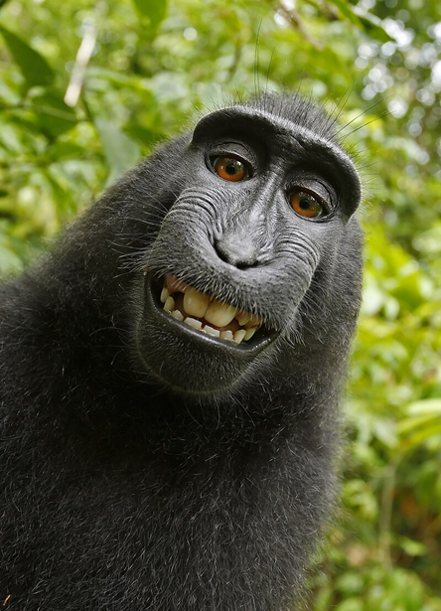
Materials produced by GenAI systems
for copyright to exist the work must have originated from a human ‘author’ who has applied sufficient ‘independent intellectual effort’ to authoring the work.
the Monkey selfie case (2014)
AI tools do not currently have a legal status and cannot own copyright

Slide 36
The USA and China
USA - Thaler (August 2023) US District Court, Columbia – the Court denied copyright protection of AI-generated output, arguing that human authorship is a fundamental requirement
CHINA - Li v Liu (November 2023) Beijing Internet Court – the prompter of the AI model is the author “as long as the AI-generated images can reflect people’s original intellectual investment”

Slide 37
The EU and the UK
2024 sees the first EU ruling - a Czech court ruled that AI-generated works cannot enjoy protection under its copyright law
June 2024 sees Regulation (EU) 2024/1689 harmonised rules on artificial intelligence. Recitals 104 to 109 and Article 53 confirm the need for copyright licenses of inputs but do not assist on authorship of outputs.
the Copyright, Designs and Patents Act 1988 allows protection for computer generated works i.e. a work "generated by a computer in circumstances that there is no human author of the work".
Under section 9(3) of the CDPA, the author for copyright ownership purposes of computer generated work is "the person by whom the arrangements necessary for the creation of the work are undertaken“

Slide 38
GenAI users as possible authors
The “prompter” of a GenAI system , if human, may be any author if they have contributed ‘independent intellectual effort’ as part of creating the work but this is likely to depend on
  the knowledge, complexity and skill used by them”, and
  the level of human intervention used to augment any output.
  Even if the complexity of a prompt could (theoretically) justify copyright to the output, AI users must also be prepared to evidence the causality of how their prompt (i.e., their creative choices) led to the creation of the output in question.

Slide 39

Proving creative input

Slide 40

Looking forward
Works generated by AI don’t presently enjoy copyright protection, but there are signs that they might in the future if they have “enough” human input.
How much is enough?
  how specific do the prompts have to be?
  what if you upload your own copyrighted image and then prompt the AI system to alter it in very specific ways?

Slide 41
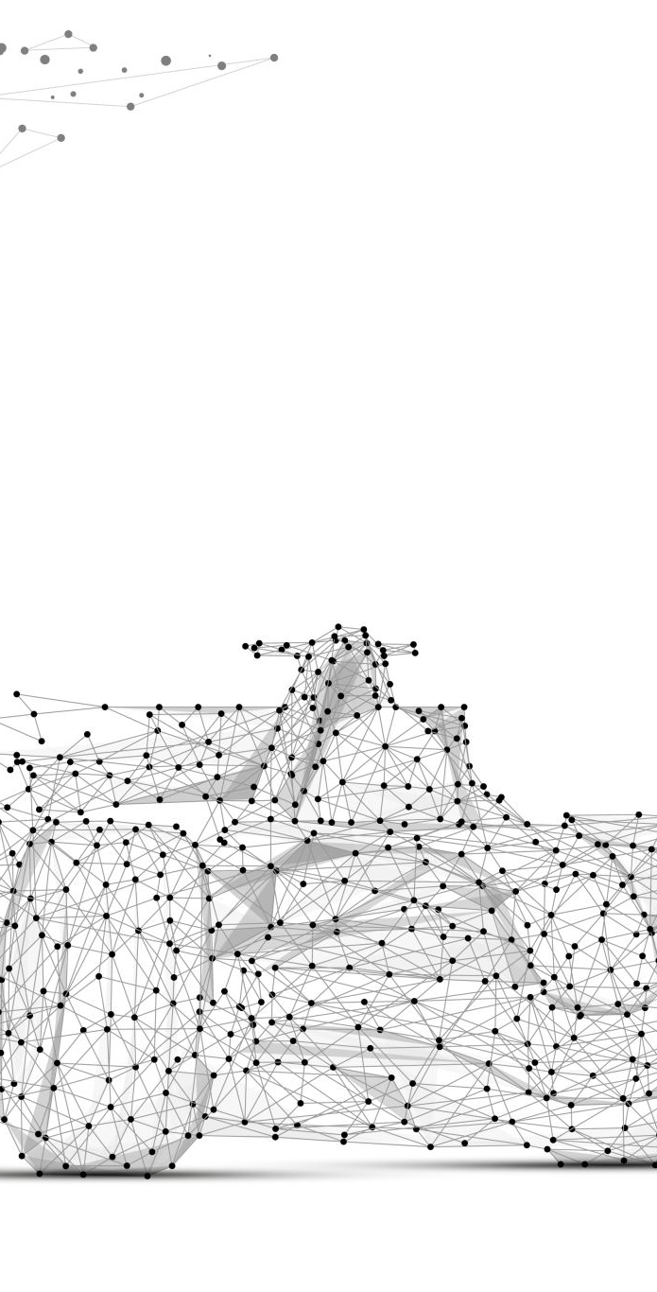
Live issues for copyright and AI
the liability of AI systems built using infringing materials
whether some or all AI outputs should be copyright protected
balance between encouraging investment in AI technologies and protecting investments that have already been made in the material being used to train them.

Slide 42

An Australian hypothetical
You have a client who owns a library with a large catalogue of old books. They have been approached by a tech startup that has put to them the following proposal:
  the library will allow the tech startup to scan and digitise the entire library. The tech startup will pay the library $50,000 and will also allow the library to retain the digital copies to use however it wants.
  in exchange, the tech startup will be entitled use the digital copies to train a new Large Language Model AI system that they are developing, which is intended to be used to write AI produced novels.
Notes:
Speaking notes:
Starting point did Josephine get the client’s consent for: the recording and the use upload of their personal information to CoPilot?
CoPilot, like many other AI tools, retains inputted data.
ASCR 8 regarding the need to follow client instructions and ASCR 9 – regarding confidentiality, are things to consider from a professional obligations perspective. Additionally, client should have provided fully informed consent.
AI tools are prone to ‘hallucinate’, the Victorian Supreme Court’s guidance with respect to the use of AI in litigation notes the risk that affidavits prepared by AI may not accurately reflect the client’s knowledge, thoughts and words.
ASCR 4 regarding the need to provide competent legal services is important to keep in mind.
AI can be influenced by various data which may be biased/discriminatory in nature.
A thorough review of the of the affidavit is required to ensure that no misrepresentations (however slight) have been made.
ASCR 37 regarding the need to supervise junior lawyers is important to consider as you should verify not only the output but also the method which has been applied to create the output.

Slide 43

Advice sought
If the library agrees to the proposal, will it breach copyright by providing the tech startup with access to the books to train their AI model?
Will the tech startup's use of the books to train its model breach copyright?
What if the library told the tech startup that the only books it had provided to the tech startup were old books that were out of copyright but this was untrue and the books provided by the library included books in which copyright still subsisted?

Slide 44

What about outputs?
The Tech Startup completes its training of the AI model using the books provided by the library, including a large volume of books that are still in copyright. The completed model is launched online, and enables users to generate a new novel, in the style of their favourite author, for $1 per novel.
The model is a great success and makes $5m in its first year.
You are approached by a well-known author who is upset that a significant number of books have been generated in her "style", for which she has received no payment.
Does she have a claim against the tech startup that owns the model?

Slide 45

Advice about outputs
An individual pays his $1 to the tech startup and generates a novel. He is astounded by how compelling and well written it is. He decides to have it printed and sold in a traditional paper format under his own name.
does printing and selling the book breach copyright or create any other risks?
can the user stop others from copying and reprinting the book?

Slide 46

Thank you

